Slide 1
FOUR GREAT ADVENTURES
GROUP 4
10442013劉萱萱、10442015彭立芠、 10442018吳詠蓁、10442021劉育均、10442022陳信瑀、10442029顏卉蘋、
10442030黃翊婷

Slide 2
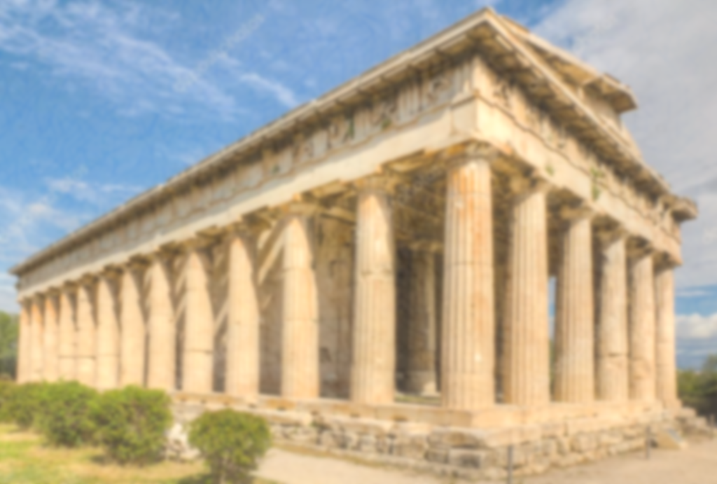
Phaethon

Slide 3
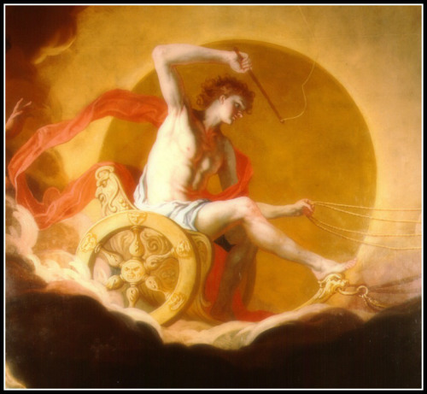
Phaethon
Phaeton was the son of Apollo by Clymene. The mother had filled the lad's head with so many stories of his father's glory that the youth was quite proud. Wherever he went he told those stories again and again until everybody was tired of him. On one occasion, when one of his playmates asked him to show his skill of coming down from sky, he felt quite hard to do it.
He came back to his mother and told the unhappy event in tears. Unable to do anything for him, she sent her son east wards to pray to Apollo for help. The sun god graciously received his son and heard the story with interest. Then he took an oath by the Styx , ready to give help according to the boy's request. But he was surprised to hear that the boy's hope was to drive his fiery. carriage.
Notes:
法厄同是阿波羅與克里敏尼生的兒子。母親給法厄同灌輸了許多父親可歌可泣的故事，以致於法厄同變得十分得意忘形。無論走到何處，他總是反覆給人們講述那些故事，最後大家都厭煩了。有一次一位夥伴要他顯露一下從天而降的本領，他頗感棘手，就痛哭流涕地將這一不快之事回家告訴了母親，母親無能為力只好將他派到東方向父親阿波羅求援。阿波羅寬厚地接待了兒子，繞有興趣地聽了事情的原委，然後阿波羅站在斯蒂克斯河邊發誓：按兒子的請求予以幫助。然而令他驚訝的是：兒子原來是想駕駛他那帶有火焰的戰車。

Slide 4
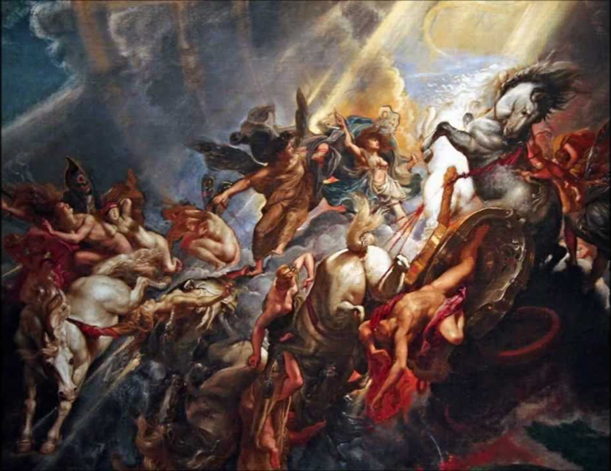
He told his son of the dangers on the way, but failed to stop him from the try. As the god had sworn by the Styx there was no going back on his word. In his desperate effort to avoid disaster, Apollo warned his son to keep to the middle course and stop the horses in time.
Phaeton joyfully jumped on the carriage and set off. Very soon he lost his way, he grew pale at the great height and the vast sky in front of him and behind. The horses ran wild. Unable to hold them, Phaeton dropped them in fear. Straight down to the earth the carriage dashed.
Notes:
他警告兒子，路上會有危險。但無濟於事。因太陽神已在河邊發過誓，一言既出、駟馬難追。為避免災難，阿波羅絕望地做最後的努力，他警告兒子要在道路中間行駛，遇事要及時勒馬。法厄同懷著喜悅的心情跳上戰車出發了。很快他就迷失了方向。看到前後令人頭暈目眩的高度和浩瀚的天空，他變得臉色蒼白。戰馬狂奔了，簡直無法駕駛。恐懼之下，他把韁繩鬆了。戰車向地面猛栽下去。

Slide 5
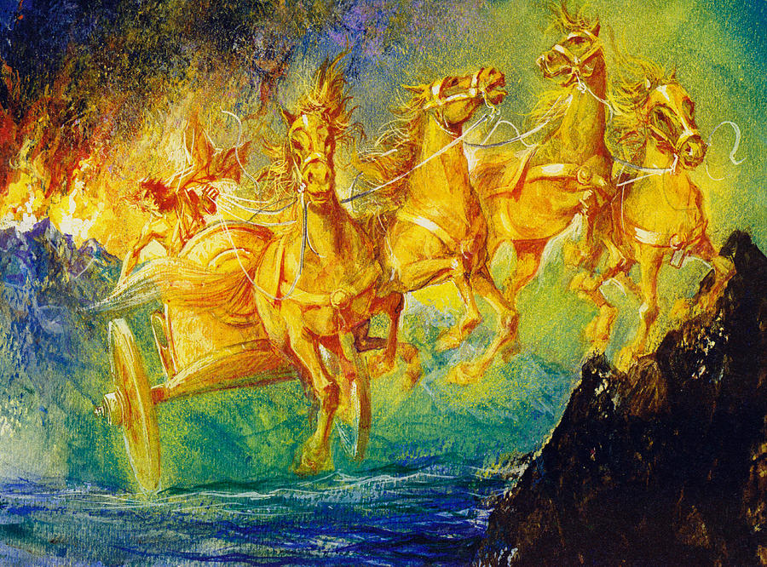
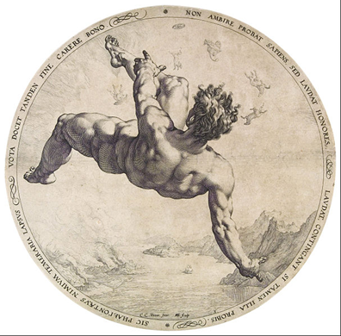
Rivers were dried up. Crop shrug down and withered. Men‘s cries of suffering rose up from the burnt earth. The enraged Zeus soon found the cause of the trouble, and without hesitation gave one of his most powerful thunderbolts at the proud and careless boy.
Phaeton dropped straight down into a river. Both parents were sad over the loss of their son. And his sisters, who were so unhappy with his untimely death, were changed into poplars and their tears turns into ambers.
Notes:
河流乾涸了，作物枯萎凋謝了。從燒焦的土地上傳來了人類受難的慟哭。暴跳如雷的宙斯很快找到了這場亂子的原因。他毫不猶豫地朝高傲自大、粗心大意的法厄同施放了雷電中最猛烈的一擊。法厄同徑直地掉入江中。父母為失去兒子而哀痛。法厄同的姐妹們也為他的夭折而悲傷。她們都變成了白楊樹，而她們的淚水則變成了琥珀。

Slide 6
Pegasus and bellerophon

Slide 7
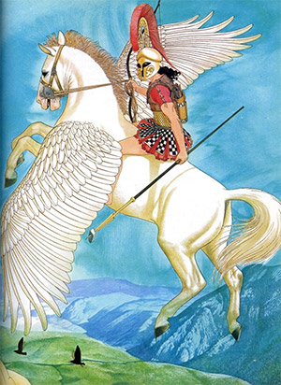
In Ephyre, the city called Corinth, Glaucus was king. His father, Sisyphus who must forever roll a stone uphill because he once betrayed a secret of Zeus. Glaucus, too.
Glaucus's son is a beautiful young man named Bellerophon, but it was also rumored that the boy's father is Poseidon.

Slide 8
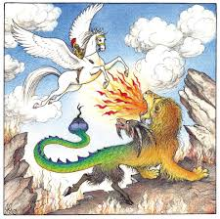
Bellerophon wanted to ride Pegasus, a winged horse, so he went to Athena‘s temple to pray. Athena helped Bellerophon to tame Pegasus.
With Pegasus, Bellerophon accomplished many tasks King Proetus gave him─include killed a monster, Chimaera.

Slide 9
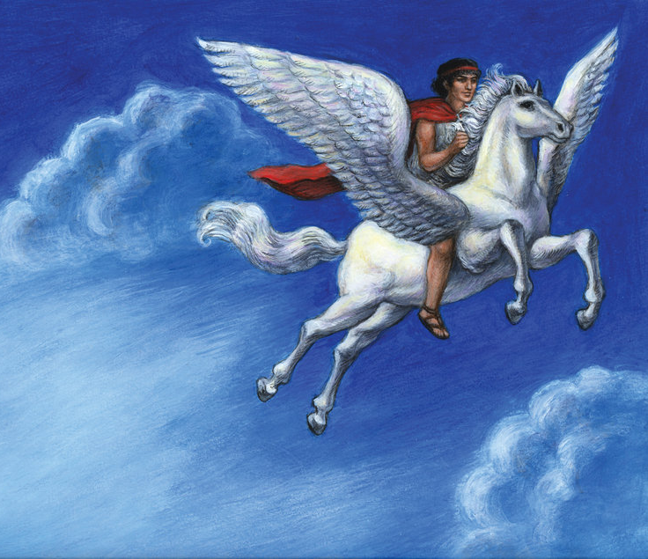
Bellerophon tried to ride Pegasus up to Olympus. He believed he could take his place there with the immortals. But Pegasus refused to take him. So Pagasus threw Bellerophon.
In the end, Pegasus found shelter in the heavenly stalls of Olympus where the steeds of Zeus were cared for.

Slide 10
Otus and Ephialtes

Slide 11
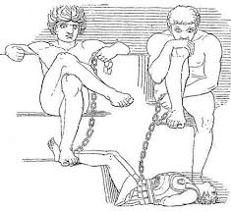
Otus and Ephialtes
Mythology Summary and Analysis
of Otus and Ephialtes. Otus and
Ephialtes are enormous twins,
sons of Poseidon. They think they
are better than the gods and
aggressively challenge them on
several occasions.

Slide 12
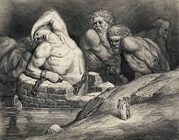
Otus and Ephialtes
First, they kidnap Ares until
the stealthy Hermes sets him
free. Next they try to put one
mountain on top of another.
Just as Zeus is going to strike
them down with a thunderbolt,
Poseidon begs to save them and Zeus agrees.

Slide 13
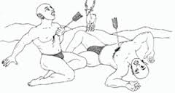
Otus and Ephialtes
Ephialtes was in love
with Artemis.
The twin brothers thought
it interesting to capture
Artemis, but the clever goddess runs away when she sees the twins. Because sheknew their evil purpose and she knew that how she would punish them

Slide 14
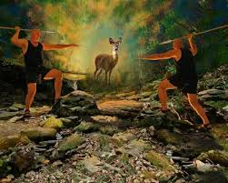
Otus and Ephialtes
The twins chased her, even as she ran over water, until she disappeared. In her place, Otus and Ephialtes see a beautiful white hind. They both throw spears at it, but it disappears as well, and
the two spears hit the two
giants instead.
Artemis thus enacts revenge.

Slide 15
Daedalus

Slide 16
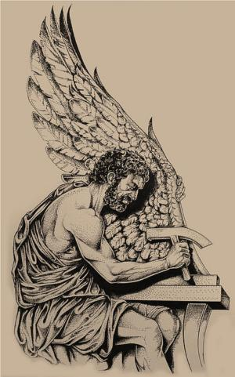
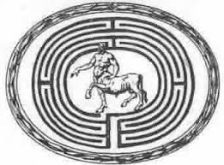
Daedalus was a craftsman and artist in Greek mythology.
He created Labyrinth, a huge maze for the Minotaur, a half-man half-bull creature, in Crete.

Slide 17
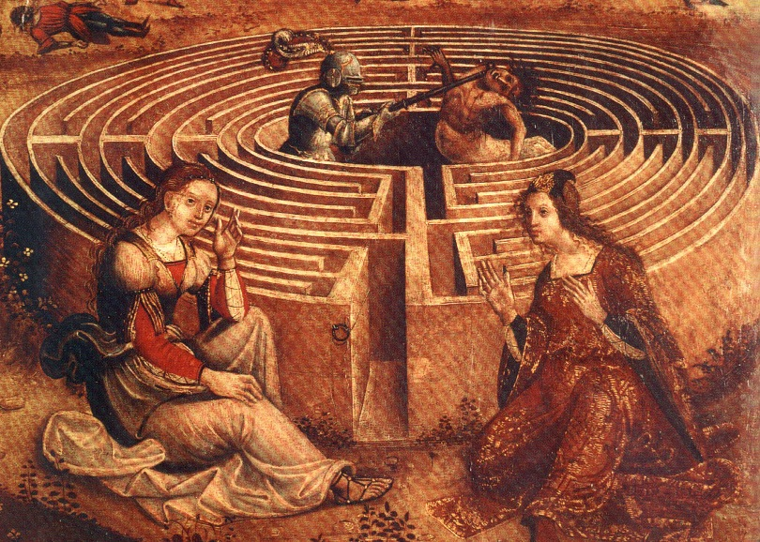
King of Athens was forced to pay tribute to King Minos by sending 7 young men and 7 young women each year to Crete to be sacrificed to the Minotaur.
One year, Theseus was sent into the Labyrinth and Daedalus showed Minos' daughter, Ariadne how Theseus could escape from it.
King Minos was angry when he learned that Daedalus had helped Theseus so he imprisoned Daedalus and his son Icarus in the Labyrinth.

Slide 18
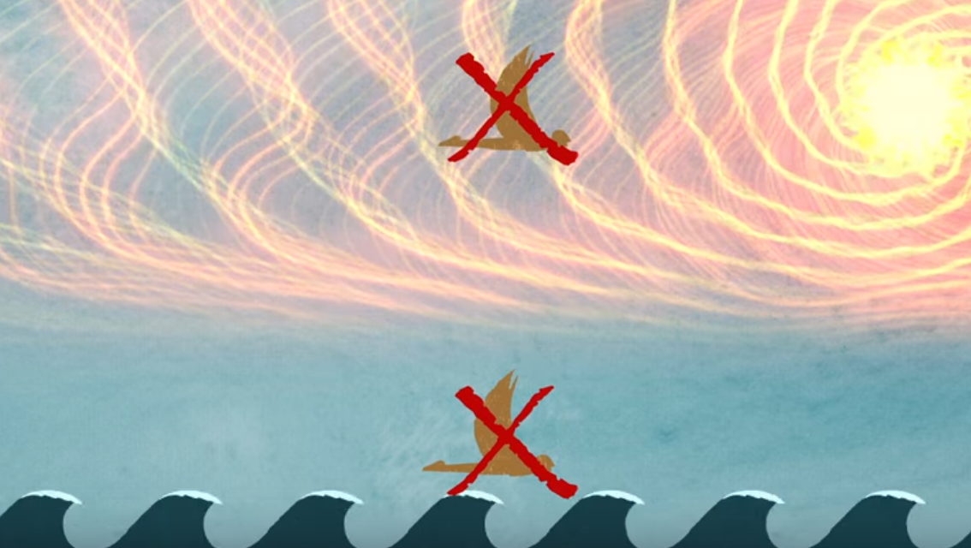
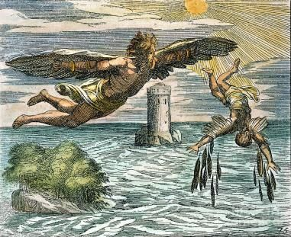
In order to escape, Daedalus made two pairs of wings for himself and his son, Icarus and warned his son if he flew too high the sun might melt the glues and the wings drop off.

Slide 19
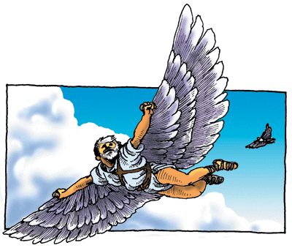
When Daedalus eventually reached the island of Sicily, King Minos had started a search for Daedalus. he asked if anyone could pass a thread through a spiraled shell.

Slide 20
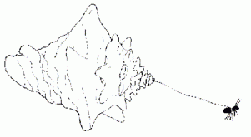
Daedalus took an ant and attached the string to it, and then lured it into the shell with a drop of honey. Thus, Minos came to Sicily to seize him. But the King refused to surrender him, so he killed Minos.

Slide 21
THANK YOU!!

